Slide 1
DataScience Lab
Boosting
Adaboost, Gradient Boost, XGBoost
Seunghan Lee
20.03.18 (Wed)

Slide 2
Contents
1
What is Boosting?
1) Ensemble method / 2) Bagging vs Boosting
2
Adaboost
Gradient Boost
XGBoost
3
Boosting with Python

Slide 3
1. What is Boosting?
Ensemble method
Bagging vs Boosting

Slide 4
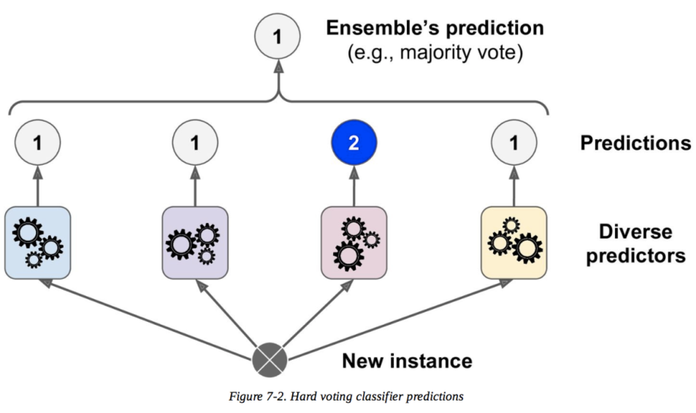
1. What is Boosting?
(1) Ensemble
In statistics and machine learning, ensemble methods use multiple learning algorithms
to obtain better predictive performance than could be obtained from any of the constituent
learning algorithms alone. ( Wikipedia )
- Use “multiple models” to predict the output
( both regression & classification )
Several Weak learner > One Strong learner
ex) Bagging & Boosting
https://miro.medium.com/max/2454/0*c0Eg6-UArkslgviw.png

Slide 5
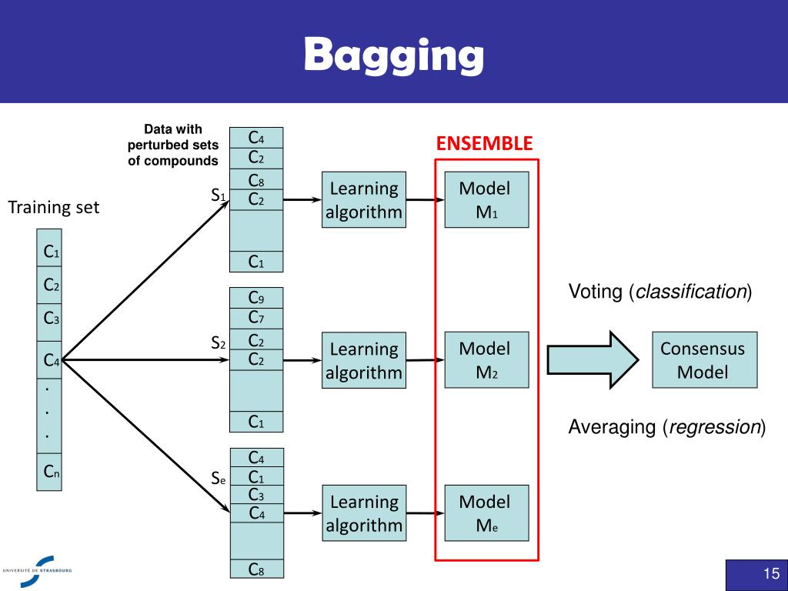
1. What is Boosting?
(2) Bagging vs Boosting
Steps of Bagging
Random sampling with replacement ( = Bootstrapping )
Select subset of features randomly
Grow the tree to the largest
Repeat 1)~3) N times ( total of N models ) -> make prediction based on these N models
https://www.slideserve.com/tarala/short-overview-of-weka

Slide 6
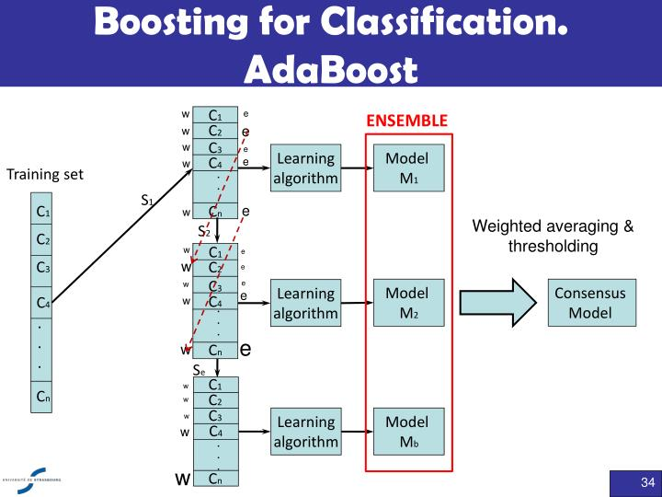
1. What is Boosting?
(2) Bagging vs Boosting
Steps of Boosting
First random sample (d1) without replacement -> train a weak learner C1
Second random sample (d2) without replacement, considering the misclassified sample in learner C1 -> train a weak learner C2
Third random sample (d2) without replacement, considering the misclassified sample in learner C1,C2 -> train a weak learner C3
Combine all the weak learners( C1~Cn ) via majority voting.
https://www.slideserve.com/tarala/short-overview-of-weka

Slide 7
1. What is Boosting?
(2) Bagging vs Boosting
 | Bagging | Boosting
 | Parallel Ensemble ( Each model is independent ) | Sequential Ensemble ( Next Model is dependent to the previous model )
Sampling | Random sample ( Bootstrapping ) | Higher vote to misclassified sample
Goal | Reduce Variance | Reduce Bias
Base Learner | Unstable Learner ( ex. Decision Tree ) | Stable Leaner ( ex. Stump )
Example) | Random Forest | XGBoost, LightGBM

Slide 8
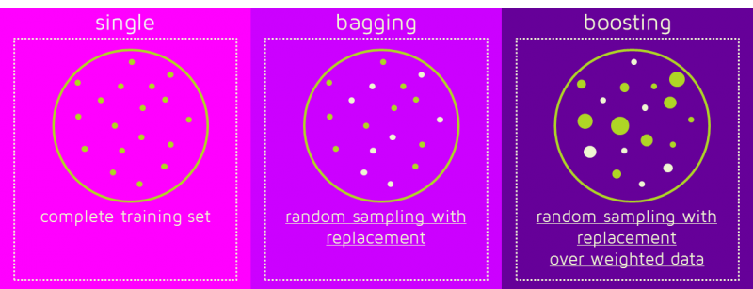
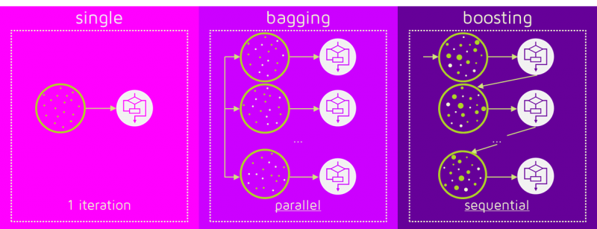
1. What is Boosting?
(2) Bagging vs Boosting
way of sampling
way of making models

Slide 9
2-a. Adaboost

Slide 10
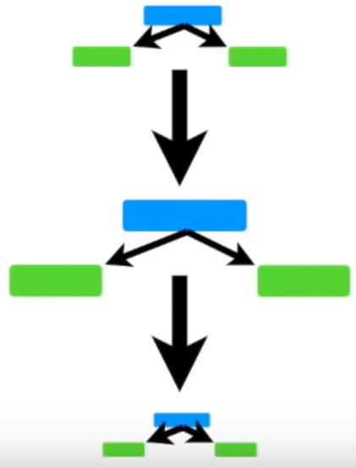
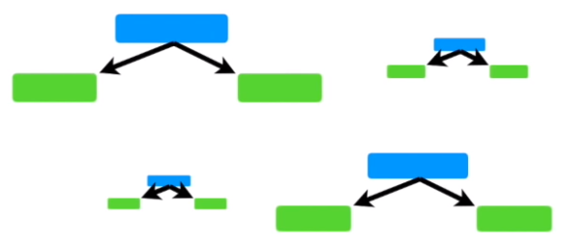
2-a. Adaboost
What is Adaboost?
Adaboost = Adaptive Boosting ( Adaptive? “more likely to choose the misclassified samples” from the previous learners )
base learner : weak learners ( not very accurate ) ex) Stump ( = a tree with 1 node & 2 leaves )
weighted sum of the output of weak learners ( = unlike RF, learners get different vote to the final output! )
weak learners are dependent to each other! ( made sequentially )
StatQuest with Josh Starmer

Slide 11
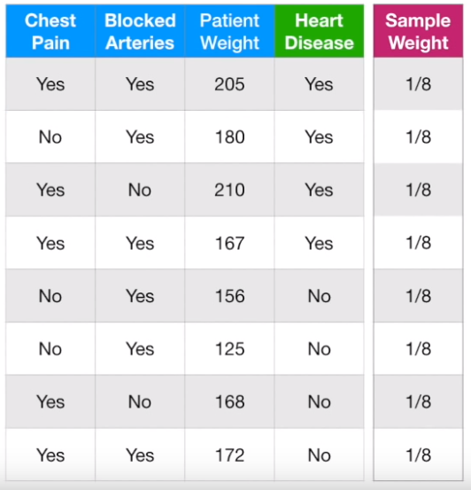

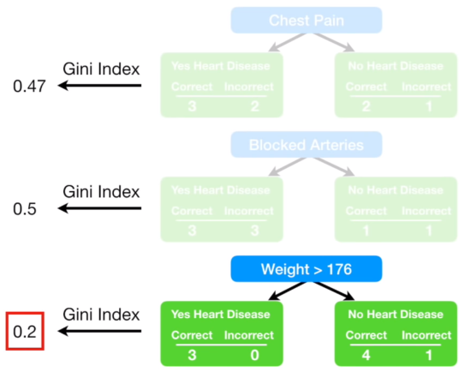
2-a. Adaboost
How does Adaboost work?
Make a Stump
with the variable which
makes the best classification
In this example,
“weight > 176” will be chosen
( How each data is important to be correctly classified ) -> will be updated!

Slide 12
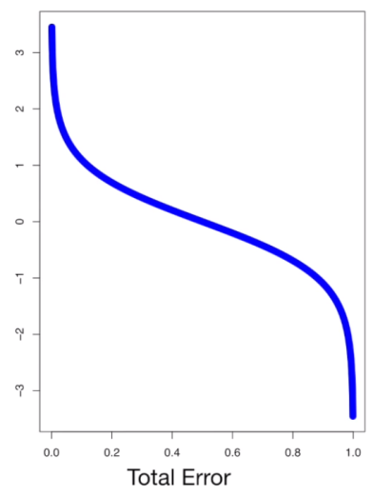
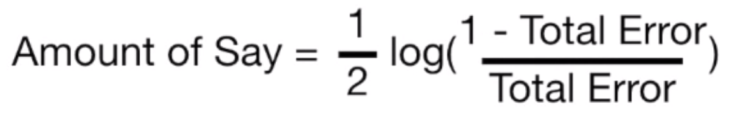
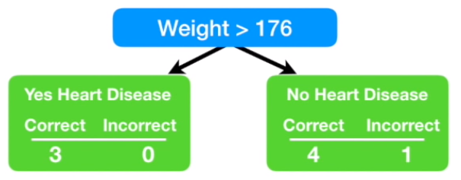
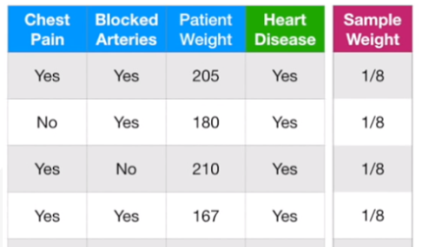
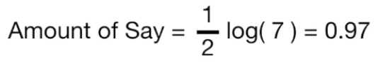
2-a. Adaboost
How does Adaboost work?
Small error -> more say
“How much say” does each stump has?
Big error -> less say
Example)

Slide 13

2-a. Adaboost
How does Adaboost work?
Small error -> more say
“How much say” does each stump has?
Need to update!
(to a SMALLER value)
Big error -> less say
Example)
Need to update!
(to a LARGER value)

Slide 14
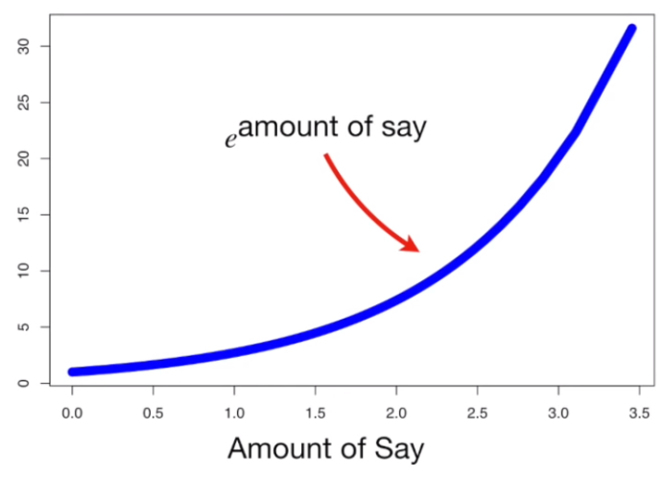
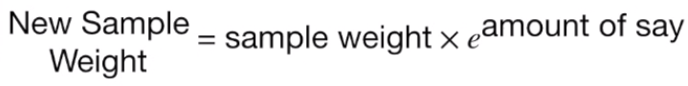
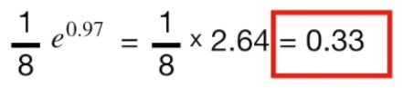

2-a. Adaboost
How does Adaboost work?
< for the “Misclassified” sample >
( increase the weight for the “incorrectly classified” sample! )
Example)
Before) 0.125
After ) 0.33

Slide 15
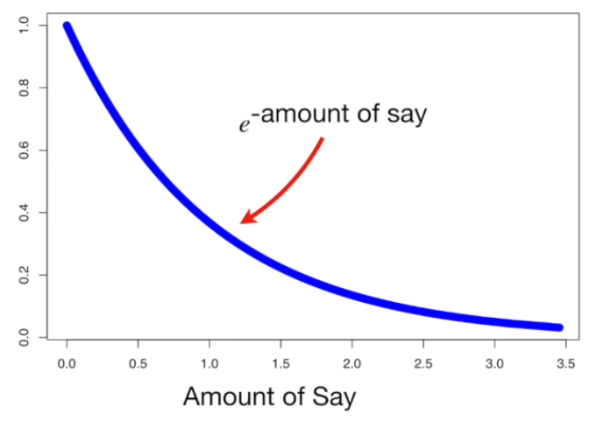
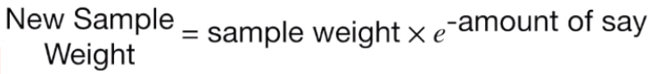
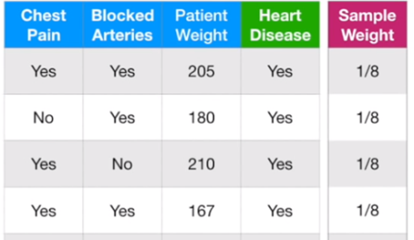
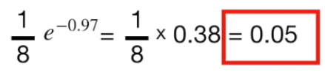
2-a. Adaboost
How does Adaboost work?
< for the “Correctly classified” sample >
( decrease the weight for the “correctly classified” sample! )
Example)
Before) 0.125
After ) 0.05

Slide 16
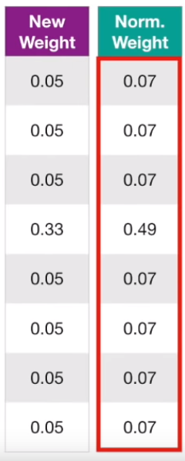
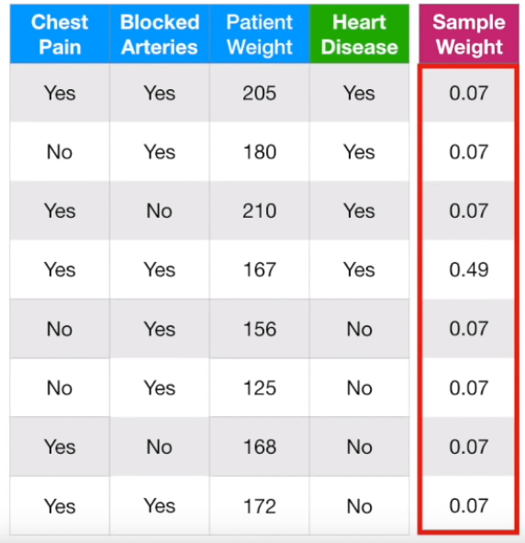
2-a. Adaboost
How does Adaboost work?
After updating the weight
( + normalization )
This becomes the new sample weight!

Slide 17

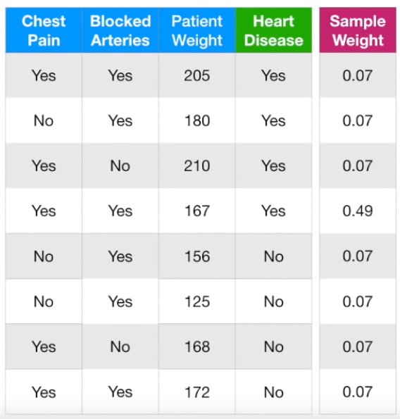
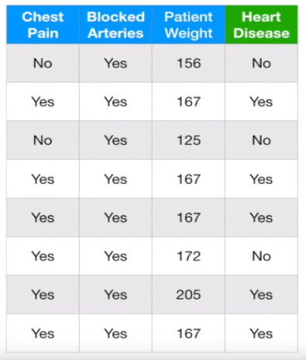
2-a. Adaboost
How does Adaboost work?
Make the next stump,
with the “new sample weight”
Option 1)
Use “weighted Gini index” to select
the feature to make new stump
Option 2)
Duplicate copies of the samples ( bigger ‘sample weight’ -> more likely to be selected)

Slide 18
2-a. Adaboost
How does Adaboost work?
Make the next stump,
with the “new sample weight”
Option 1)
Use “weighted Gini index” to select
the feature to make new stump
Option 2)
Duplicate copies of the samples ( bigger ‘sample weight’ -> more likely to be selected)

Slide 19

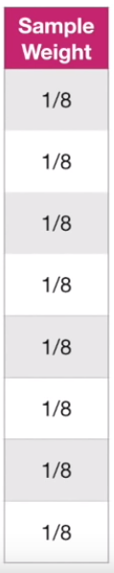
2-a. Adaboost
How does Adaboost work?
Same sample weights doesn’t mean same importance to every sample!
( important samples are duplicated! )
Give equal weight to all the samples!

Slide 20
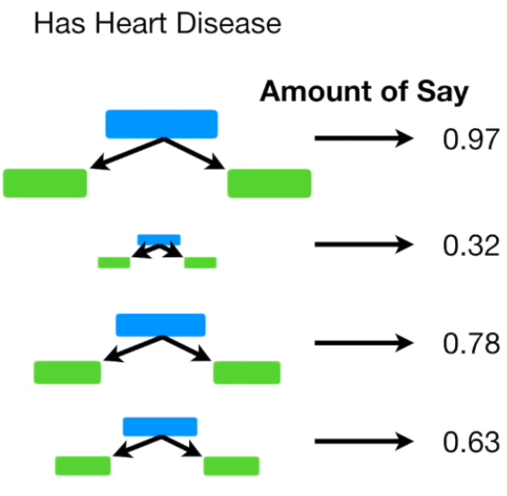
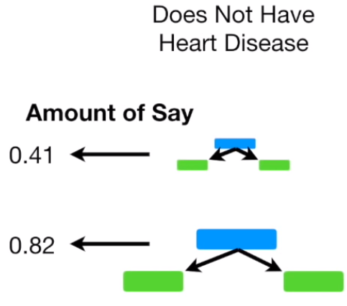
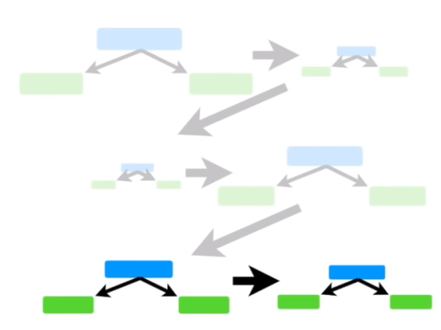
2-a. Adaboost
How does Adaboost work?
Make models(stumps) sequentially
>
Total Sum : 2.7
Total Sum : 1.23
How to predict
the final output?
Result : “Has Heart Disease”

Slide 21
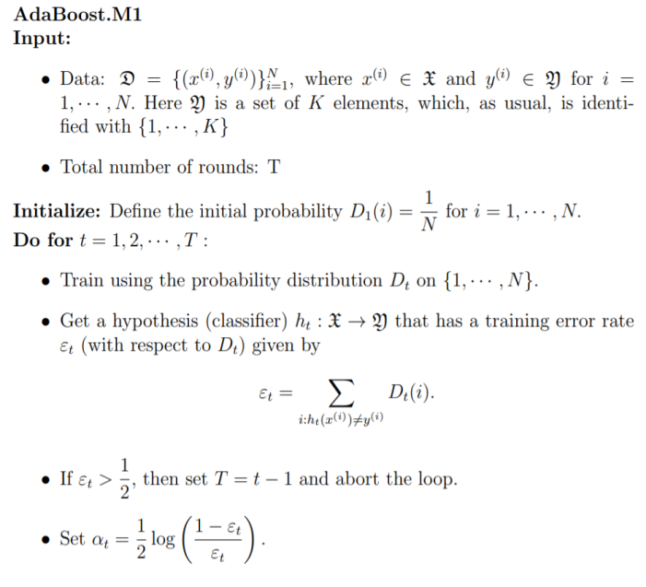
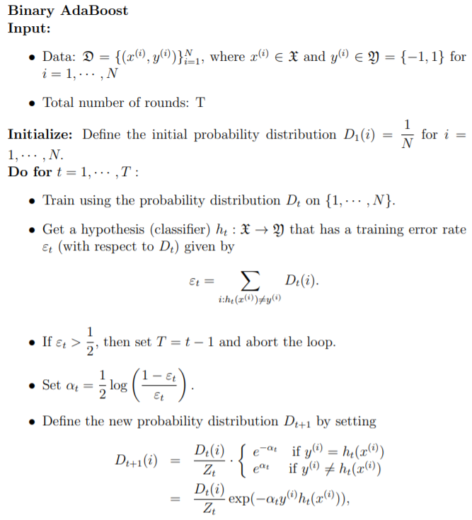
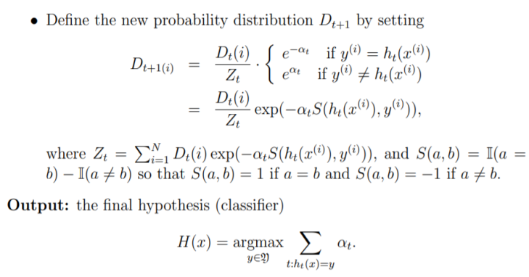
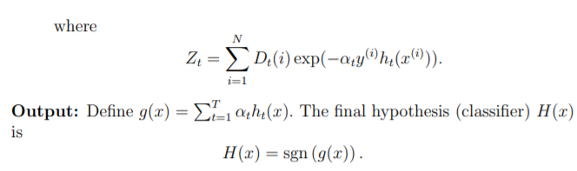
2-a. Adaboost
How does Adaboost work?
Lecture 11: Boosting (I) AdaBoost (Draft: version 0.9.2) Seoul National University, Hyeong In Choi
binary
Multi-class
Extend to multi-class

Slide 22
2-a. Adaboost
Adaboost Summary
Combine weak learners to make classifications
Some learners have more say than over learners
Each learner is made by considering the result of the previous learner’s mistake

Slide 23
2-b. Gradient Boost

Slide 24
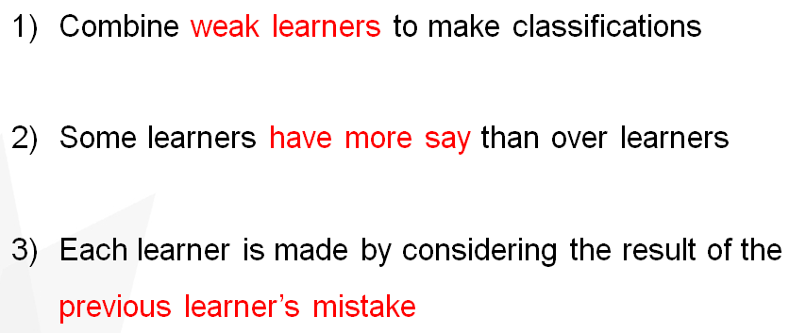
2-b. Gradient Boost
What is Gradient Boost?
not so much different with Adaboost
difference? Can be expressed in more general terms! ( by using “gradient” ) + use trees larger than stumps as base learners
Minimizing the cost(loss) function
1. Gradient Boosting Regression
y = f(x) + e1
e1 = g(x) + e2
e2 = h(x) + e3
2. Gradient Boosting Classification
Y = f(x) + g(x) + h(x) + …

Slide 25
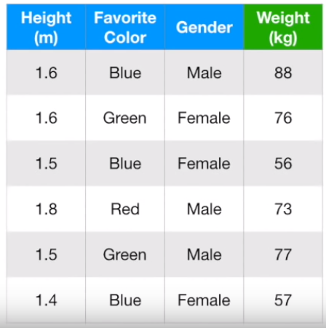
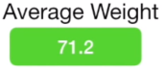
2-b. Gradient Boost
1. Gradient Boost Regression
1
First, make a “leaf ( = guess for the y value )”
( initial leaf : average of all the y values )
( = first predicted y )

Slide 26
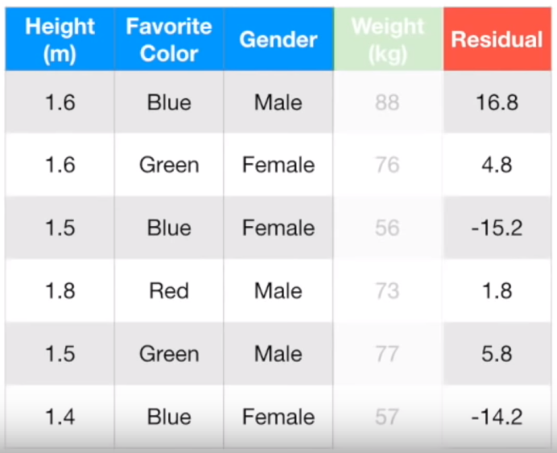
2-b. Gradient Boost
1. Gradient Boost Regression
1
2
First, make a “leaf ( = guess for the y value )”
( initial leaf : average of all the y values )
Then, predict the “residual” ( build the next model (tree) predicting the residuals )
( = first predicted y )

Slide 27

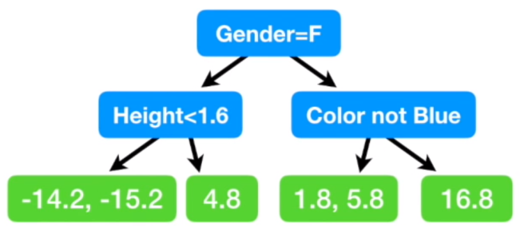

2-b. Gradient Boost
1. Gradient Boost Regression
( usually 8~32 leaves )
Replace the residuals into their average
-14.7
3.8

Slide 28
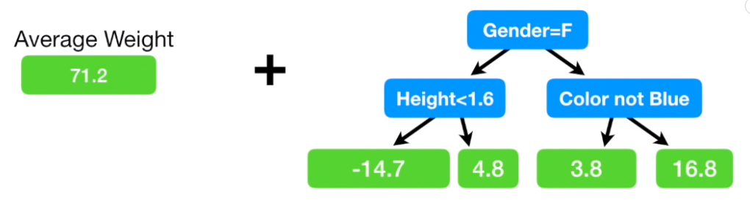
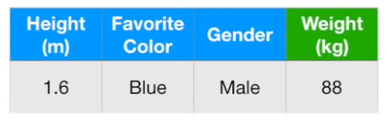
2-b. Gradient Boost
1. Gradient Boost Regression
100% correct ( no error )
Overfitting!

Slide 29
2-b. Gradient Boost
1. Gradient Boost Regression
100% correct ( no error )
Overfitting!
lr x
72.9
( If learning rate = 0.1 )
71.2 + (0.1 x 16.8) = 72.9

Slide 30
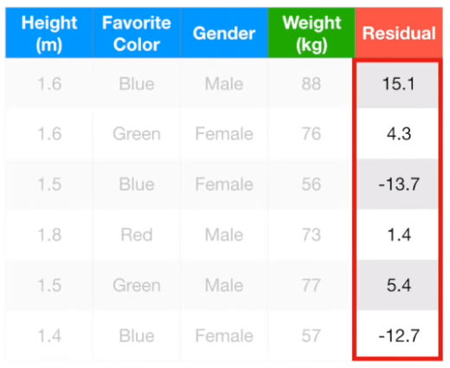
2-b. Gradient Boost
1. Gradient Boost Regression
new residuals
( becomes smaller )
88 – (71.2 + 0.1x16.8) =

Slide 31
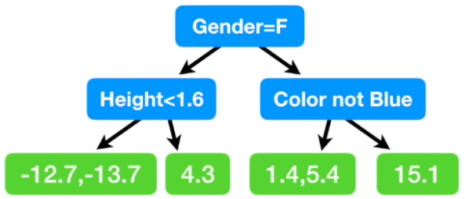
2-b. Gradient Boost
1. Gradient Boost Regression
new residuals
( becomes smaller )
88 – (71.2 + 0.1x16.8) =
into -13.2
Into 3.4
3
Then, predict the “residual’s residual” ( build the next model (tree) predicting the residuals )

Slide 32
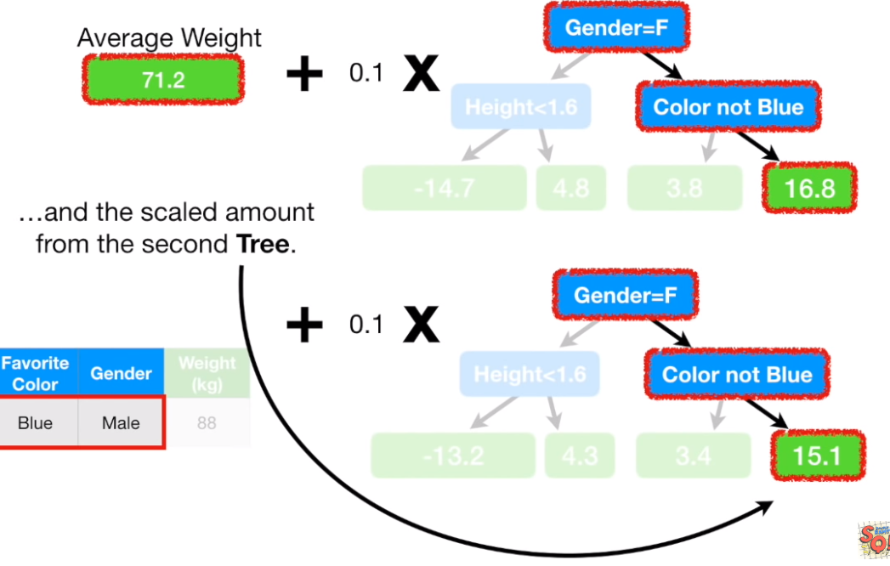
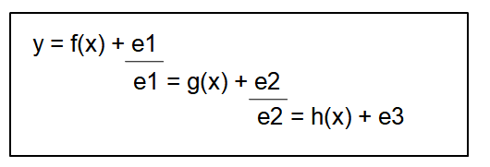
2-b. Gradient Boost
1. Gradient Boost Regression
74.4
71.2 + (0.1 x 16.8) + (0.1 x 15.1) = 74.4

Slide 33
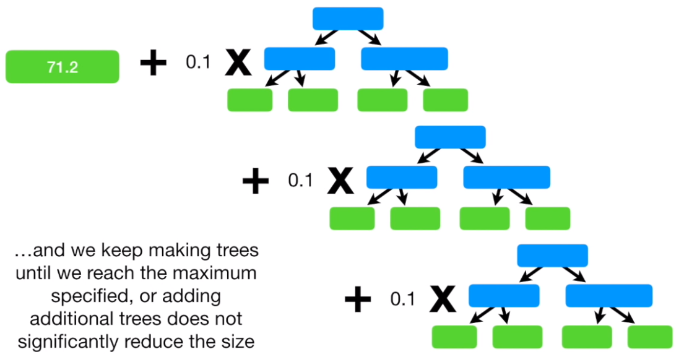
2-b. Gradient Boost
1. Gradient Boost Regression
Keep making the sequential trees!
( until specified level, or until the residuals doesn’t significantly drops )

Slide 34
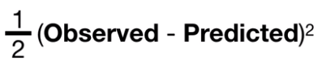
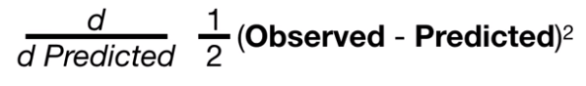
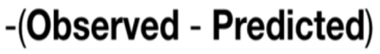

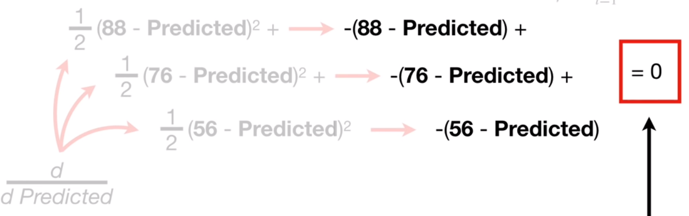
2-b. Gradient Boost
1. Gradient Boost Regression
Mathematical Expression
Loss Function =
To minimize this loss function
=
= 0
= 0

Slide 35
2-b. Gradient Boost
1. Gradient Boost Regression
Mathematical Expression
Loss Function =
To minimize this loss function
=
= 0
That is why we kept making
the predicted value as the “AVERAGE” value!
= 0

Slide 36
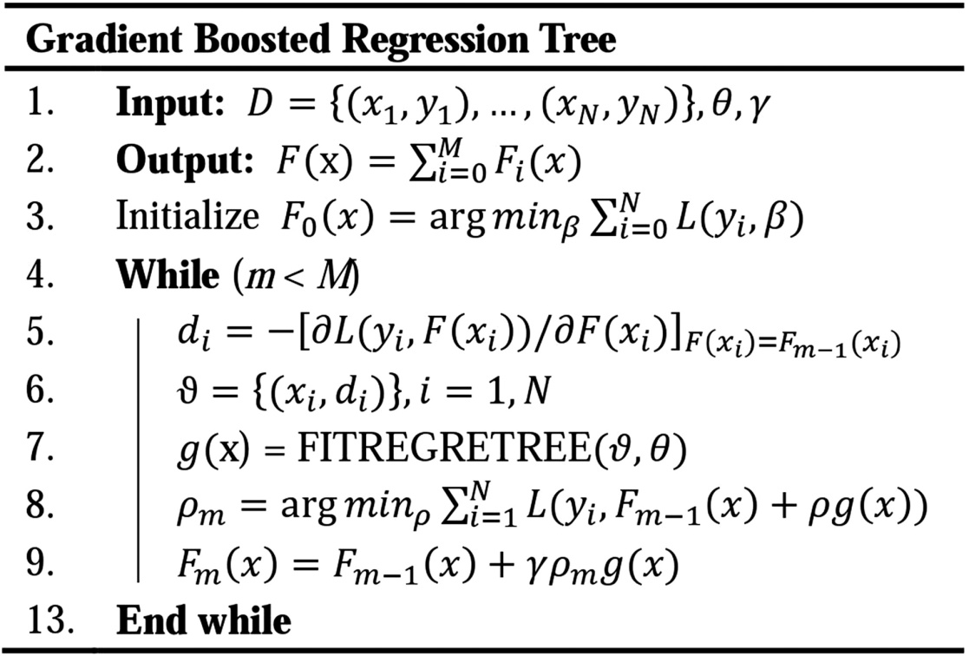
2-b. Gradient Boost
1. Gradient Boost Regression
https://ascelibrary.org/cms/asset/
Done!

Slide 37


2-b. Gradient Boost
1. Gradient Boost Regression
First prediction = “average” of all y values
Loss Function : MSE
Y = f(x) + g(x) + e2

Slide 38


2-b. Gradient Boost
2. Gradient Boost Classification
4 Yes, 2 No
Odds ratio (of yes): 4/2 = 2
Odds ratio (of no) : 2/4 = 0.5
Log(2) = 0.7
Log(0.5) = -0.7
Log Odds Ratio?
1
First, make a “leaf ( = guess for the y value )”
( initial leaf : log odds ratio of the highest value )
( = first predicted y )

Slide 39

2-b. Gradient Boost
2. Gradient Boost Classification
1) Log Odds Ratio ( = Logit )
If p is a probability, then p/(1 − p) is the corresponding odds

Slide 40

2-b. Gradient Boost
2. Gradient Boost Classification
1) Log Odds Ratio ( = Logit )
If p is a probability, then p/(1 − p) is the corresponding odds
Example)
Chance of winning?
Odds are 2.5
that DSL will win!
5
DSL
YBIGTA
log(5/2) = 0.916
2
( probability (p) = 5/7 )
5
2
Why log?
(5/7) / (2/7) = 5/2
1/6
6/1

Slide 41

2-b. Gradient Boost
2. Gradient Boost Classification
2) Logistic Function ( = Sigmoid )
As a method to turn ‘log odds ratio’ back to ‘probability’

Slide 42

2-b. Gradient Boost
2. Gradient Boost Classification
2) Logistic Function ( = Sigmoid )
As a method to turn ‘log odds ratio’ back to ‘probability’
Example)
( The probability was 5/7 )
log(5/2) = 0.916
f( log(5/2) ) = 5/7

Slide 43
2-b. Gradient Boost
2. Gradient Boost Classification
4 Yes, 2 No
Odds ratio (of yes): 4/2 = 2
Odds ratio (of no) : 2/4 = 0.5
Log(2) = 0.7
Log(0.5) = -0.7
1
First, make a “leaf ( = guess for the y value )”
( initial leaf : log odds ratio of the highest value )
( = first predicted y )

Slide 44

2-b. Gradient Boost
2. Gradient Boost Classification
4 Yes, 2 No
Odds ratio (of yes): 4/2 = 2
Odds ratio (of no) : 2/4 = 0.5
Log(2) = 0.7
Log(0.5) = -0.7
1
First, make a “leaf ( = guess for the y value )”
( initial leaf : log odds ratio of the highest value )
Put log odds ratio into sigmoid function
( = first predicted y )

Slide 45
2-b. Gradient Boost
2. Gradient Boost Classification
4 Yes, 2 No
Odds ratio (of yes): 4/2 = 2
Odds ratio (of no) : 2/4 = 0.5
Log(2) = 0.7
Log(0.5) = -0.7
Therefore, every sample will be classified ‘Yes’ for the initial guess!
1
(threshold : 0.5)
Bigger than 0.5 -> classify into ‘Yes’
Smaller than 0.5 -> classify into ‘No’
First, make a “leaf ( = guess for the y value )”
( initial leaf : log odds ratio of the highest value )
Put log odds ratio into sigmoid function
( = first predicted y )

Slide 46

2-b. Gradient Boost
2. Gradient Boost Classification
( Yes = 1, No = 0 )
( = 1(actual) – 0.7(predicted) )
( = 0(actual) – 0.7(predicted) )
2
Calculate Error based on the first prediction

Slide 47
2-b. Gradient Boost
2. Gradient Boost Classification
( Yes = 1, No = 0 )
( = 1(actual) – 0.7(predicted) )
( = 0(actual) – 0.7(predicted) )
Don’t get confused!
0.7 is not “log odds ratio”!
It is “probability”
2
Calculate Error based on the first prediction

Slide 48

2-b. Gradient Boost
2. Gradient Boost Classification
( Yes = 1, No = 0 )
( = 1(actual) – 0.7(predicted) )
( = 0(actual) – 0.7(predicted) )
Don’t get confused!
0.7 is not “log odds ratio”!
It is “probability”
2
3
Calculate Error based on the first prediction
Make a tree, predicting the “residuals”

Slide 49

2-b. Gradient Boost
2. Gradient Boost Classification
( in Regression )
A bit different in Classification

Slide 50

2-b. Gradient Boost
2. Gradient Boost Classification
( in Regression )
A bit different in Classification
( in Classification )
Log odds ratio
Probability
MISMATCH! Can’t just add them together!
How to make ‘probability’ compatible with ‘log odds ratio’?

Slide 51


2-b. Gradient Boost
2. Gradient Boost Classification
( = -3.3 )
With this formula, we can change the value of terminal node (which is probability) to be expressed in log odds ratio!
( = -1 )

Slide 52
2-b. Gradient Boost
2. Gradient Boost Classification
-3.3
( = -3.3 )
-1
1.4
( = -1 )
Replace the value! ( to be compatible with ‘log odds ratio’ )

Slide 53


2-b. Gradient Boost
2. Gradient Boost Classification
Prediction (before) : 0.7
Prediction (after) : 0.7 + (0.8x1.4) = 1.82 convert 1.82 (log odds ratio) into 0.9 (probability)
3
Make a new prediction! ( considering the tree newly made )

Slide 54

2-b. Gradient Boost
2. Gradient Boost Classification
( = 1(actual) – 0.9(predicted) )
( = 1(actual) – 0.5(predicted) )
4
Calculate error, based on the second prediction!

Slide 55

2-b. Gradient Boost
2. Gradient Boost Classification
( = 1(actual) – 0.9(predicted) )
( = 1(actual) – 0.5(predicted) )
4
5
Calculate error, based on the second prediction!
Keep making sequential trees!

Slide 56


2-b. Gradient Boost
2. Gradient Boost Classification
Ex) How would the person like below be classified?
0.7 + (0.8x1.4) + (0.8x0.6) = 2.3
( into Logistic function )
f(2.3) = exp(2.3) / (1+exp(2.3)) = 0.9
Therefore, it will be classified as ‘Yes’

Slide 57

2-b. Gradient Boost
2. Gradient Boost Classification
Mathematical Expression
Loss Function :
( also called binary-cross entropy )

Slide 58

2-b. Gradient Boost
2. Gradient Boost Classification
Mathematical Expression
Loss Function :
( also called binary-cross entropy )
Case 1) Actual(=Observed) = 1, Predicted = 1
Case 2) Actual(=Observed) = 1, Predicted = 0.5
Case 3) Actual(=Observed) = 1, Predicted = 0
Log loss : 0
Log loss : 0.69
Log loss : infinity

Slide 59
2-b. Gradient Boost
2. Gradient Boost Classification

Slide 60
2-b. Gradient Boost
2. Gradient Boost Classification
Classification
Almost the same as the Regression Model!

Slide 61
2-b. Gradient Boost
2. Gradient Boost Classification
First prediction = “average” of all y values
Loss Function : MSE
Y = f(x) + g(x) + e2

Slide 62
2-b. Gradient Boost
2. Gradient Boost Classification
Classification
First prediction = “log odds ratio” of the mode
Loss Function : Log Loss
Y = f(x) + g(x) + e2

Slide 63
2-c. XGBoost

Slide 64
2-c. XGBoost
1. Characteritics of XGBoost
XGBoost ( eXtreme Gradient Boost )
Consists of lots of parts!
Gradient Boost
Regularization
Unique Regression Tree
Approximate Greedy Algorithm
Weighted Quantile Sketch
Sparsity-Aware Split Finding
Parallel Learning
Cache-Aware Access
Blocks for Out-of-Core Computation
1. XGBoost Regression
2. XGBoost Classification

Slide 65
2-c. XGBoost
2. XGBoost Regression

Slide 66


2-c. XGBoost
2. XGBoost Regression
Unique Regression Tree!
Example with simple data)
X : drug dosage
Y : drug Effectiveness
residuals
1
Initial Prediction : 0.5 (default)
( both in Regression & Classification )

Slide 67

2-c. XGBoost
2. XGBoost Regression
( same as non-extreme GB )
2
Then, predict the “residual” ( build the next model (tree) predicting the residuals )

Slide 68



2-c. XGBoost
2. XGBoost Regression
HOW?
Step 1.
Put all the residuals to the same leaf
And calculate a “similarity score”
( same as non-extreme GB )
2
( lambda : regularization term )
Then, predict the “residual” ( build the next model (tree) predicting the residuals )
= 4

Slide 69

2-c. XGBoost
2. XGBoost Regression
HOW?
Step 2.
Split the leaf, which gives the most “Gain”
sim = 4
1
Drug Dosage < 15
Which split criterion should we choose?
2
Drug Dosage < 22.5
3
Drug Dosage < 15

Slide 70
2-c. XGBoost
2. XGBoost Regression
HOW?
Which one?
Step 2.
Split the leaf, which gives the most “Gain”
1
2
3
sim = 4
1
Drug Dosage < 15
Which split criterion should we choose?
2
Drug Dosage < 22.5
3
Drug Dosage < 15

Slide 71




2-c. XGBoost
2. XGBoost Regression
Example)
14.08 =
1
Drug Dosage < 15
Which split criterion should we choose?
2
Drug Dosage < 22.5
3
Drug Dosage < 30
D.D < 15
sim = 4
D.D < 22.5
sim = 4
D.D < 30
sim = 4
Sim = 110.25
Sim = 14.08
Sim = 8
Sim =0
Sim = 4.08
Sim = 56.25

Slide 72
2-c. XGBoost
2. XGBoost Regression
Example)
14.08 =
1
Drug Dosage < 15
Which split criterion should we choose?
2
Drug Dosage < 22.5
3
Drug Dosage < 30
D.D < 15
sim = 4
D.D < 22.5
sim = 4
D.D < 30
sim = 4
Sim = 110.25
Sim = 14.08
Sim = 8
Sim =0
Sim = 4.08
Sim = 56.25
Gain
(110.25 + 14.08) - 4 = 120.33
Gain
(8 + 0) - 4 = 4
Gain
(4.08 + 56.25) – 4 = 56.33

Slide 73
2-c. XGBoost
2. XGBoost Regression
Example)
14.08 =
1
Drug Dosage < 15
Which split criterion should we choose?
2
Drug Dosage < 22.5
3
Drug Dosage < 30
D.D < 15
sim = 4
D.D < 22.5
sim = 4
D.D < 30
sim = 4
Sim = 110.25
Sim = 14.08
Sim = 8
Sim =0
Sim = 4.08
Sim = 56.25
Gain
(110.25 + 14.08) - 4 = 120.33
Gain
(8 + 0) - 4 = 4
Gain
(4.08 + 56.25) – 4 = 56.33

Slide 74

2-c. XGBoost
2. XGBoost Regression
choose “D.D<15” as the criterion
Gain : 120.33
D.D < 15
sim = 4
Sim = 110.25
Sim = 14.08
Gain : 120.33
Do the same thing!
Gain : 140.17

Slide 75
2-c. XGBoost
2. XGBoost Regression
HOW?
choose “D.D<15” as the criterion
Step 3.
Prune the tree ( if necessary )
To Prevent
Overfitting!
Gain : 120.33
D.D < 15
sim = 4
Gain : 120.33
Gain : 140.17
Sim = 110.25
Sim = 14.08
Gain : 120.33
New parameter : ‘gamma’
If gamma = 130 : ( 140.17 > 130 ) -> Prune X
If gamma = 150 :
( 140.17 < 150 ) -> Prune O -> ( 120.33 < 150) -> Prune O
NO GAIN,
NO PRUNE
Do the same thing!
Gain : 140.17

Slide 76
2-c. XGBoost
2. XGBoost Regression
Another method for preventing overfitting ( regularization )

Slide 77
2-c. XGBoost
2. XGBoost Regression
Another method for preventing overfitting ( regularization )
What happens if lambda gets larger?
lambda ↑ -> similarity score ↓ -> More chance of getting pruned

Slide 78

2-c. XGBoost
2. XGBoost Regression
Step 4.
Predict output values of each leaf !
these are all RESIDUALS, not output values!
How will these values (of leaves) change?

Slide 79



2-c. XGBoost
2. XGBoost Regression
Step 4.
Predict output values of each leaf !
-10.5
7
-7.5
these are all RESIDUALS, not output values!

Slide 80

2-c. XGBoost
2. XGBoost Regression
Step 5.
Predict the final outcome!
…
…
…

Slide 81


2-c. XGBoost
2. XGBoost Regression
Step 5.
Predict the final outcome!
Getting a more precise prediction as the model is made!
( But be careful of overfitting! )

Slide 82
2-c. XGBoost
3. XGBoost Classification

Slide 83


2-c. XGBoost
3. XGBoost Classification
Example with simple data)
X : drug dosage
Y : Effective / Not Effective
1
Initial Prediction : 0.5 (default)
( both in Regression & Classification )

Slide 84

2-c. XGBoost
3. XGBoost Classification
( same as non-extreme GB )
2
Then, predict the “residual” ( build the next model (tree) predicting the residuals )

Slide 85



2-c. XGBoost
3. XGBoost Classification
HOW?
Step 1.
Put all the residuals to the same leaf
And calculate a “similarity score”
( same as non-extreme GB )
2
( lambda : regularization term )
Then, predict the “residual” ( build the next model (tree) predicting the residuals )
= 0
4 x (0.5x(1-0.5))

Slide 86
2-c. XGBoost
3. XGBoost Classification
HOW?
Nothing is different from XGBoost Regression,
except the “similarity score”
Step 1.
Put all the residuals to the same leaf
And calculate a “similarity score”
( in Regression )
( same as non-extreme GB )
2
( lambda : regularization term )
( in Classification )
Then, predict the “residual” ( build the next model (tree) predicting the residuals )
= 0
4 x (0.5x(1-0.5))

Slide 87

2-c. XGBoost
2. XGBoost Regression
HOW?
Step 2.
Split the leaf, which gives the most “Gain”
sim = 0
1
Drug Dosage < 15
Which split criterion should we choose?
2
Drug Dosage < 22.5
3
Drug Dosage < 15

Slide 88



2-c. XGBoost
2. XGBoost Regression
Calculate the similarity score!
sim = 0
HOW?
Step 2.
Split the leaf, which gives the most “Gain”
sim = 0.33
sim = 1
sim = 0
1
Drug Dosage < 15
Which split criterion should we choose?
Repeat this
for the next leaf
2
Drug Dosage < 22.5
3
Drug Dosage < 15

Slide 89
2-c. XGBoost
3. XGBoost Classification
Step 3.
Pruning the tree
parameter ‘gamma’ ( minimum gain to make a split! )
parameter ‘lambda’ ( regularization term )

Slide 90
2-c. XGBoost
3. XGBoost Classification
Step 3.
Pruning the tree
parameter ‘gamma’ ( minimum gain to make a split! )
parameter ‘lambda’ ( regularization term )
minimum number of residuals in each leaf ( new term, ‘cover’ )

Slide 91

2-c. XGBoost
3. XGBoost Classification
Step 3.
Pruning the tree
( in regression )
cover can be defined as ‘number of residuals’
default value : 1 -> means that it has no affect on the growth of tree
parameter ‘gamma’ ( minimum gain to make a split! )
parameter ‘lambda’ ( regularization term )
minimum number of residuals in each leaf ( new term, ‘cover’ )

Slide 92
2-c. XGBoost
3. XGBoost Classification
Step 3.
Pruning the tree
( in regression )
cover can be defined as ‘number of residuals’
default value : 1 -> means that it has no affect on the growth of tree
parameter ‘gamma’ ( minimum gain to make a split! )
parameter ‘lambda’ ( regularization term )
minimum number of residuals in each leaf ( new term, ‘cover’ )
Example)
‘cover’ for this leaf is
1 x ( 0.5 x (1-0.5) ) = 0.25

Slide 93
2-c. XGBoost
3. XGBoost Classification
Step 3.
Pruning the tree
( in regression )
cover can be defined as ‘number of residuals’
default value : 1 -> means that it has no affect on the growth of tree
parameter ‘gamma’ ( minimum gain to make a split! )
parameter ‘lambda’ ( regularization term )
minimum number of residuals in each leaf ( new term, ‘cover’ )
Example)
‘cover’ for this leaf is
1 x ( 0.5 x (1-0.5) ) = 0.25
Default value for cover : 1
( 0.25 < 1 ) -> get pruned!
we call this parameter ‘cover’ as “min_child_weight”

Slide 94



2-c. XGBoost
3. XGBoost Classification
Step 4.
Predict the output values of each leaf
Output value =
-2
-2
2
these are all RESIDUALS, not output values!

Slide 95


2-c. XGBoost
3. XGBoost Classification
Step 5.
Predict the final outcome
learning rate
Probability
…
…
…
Log Odds Ratio

Slide 96
2-c. XGBoost
3. XGBoost Classification
Step 5.
Predict the final outcome
learning rate
0.5 is “probability”, so we have to convert this into “log odds ratio”
…
…
…

Slide 97
2-c. XGBoost
3. XGBoost Classification
Step 5.
Predict the final outcome
learning rate
log(odds) = log( 0.5 / (1-0.5) ) = 0
…
…
…

Slide 98



2-c. XGBoost
3. XGBoost Classification
Ex) What is the predicted class for the sample below, with the red color? ( let learning rate = 0.3 )
Answer : 1) 0 + ( 0.3 x (-2) ) = - 0.6 ( this is in terms of ‘log(odds)’ ! Have to convert into probability )
2) Probability = = 0.35 -> Predicted as ‘NO EFFECT’

Slide 99


2-c. XGBoost
3. XGBoost Classification
Gradient Boosting Classification
XGBoost Classification

Slide 100

2-c. XGBoost
3. XGBoost Classification
Parameters of XGBoost
https://www.researchgate.net/figure/Key-parameters-used-for-XGBoost-classification_tbl1_322791200

Slide 101

2-c. XGBoost
3. XGBoost Classification
Mathematical Expressions
https://brunch.co.kr/@snobberys/137

Slide 102

2-c. XGBoost
3. XGBoost Classification
Mathematical Expressions

Slide 103


2-c. XGBoost
3. XGBoost Classification
Mathematical Expressions
At time ‘t’

Slide 104

2-c. XGBoost
3. XGBoost Classification
Mathematical Expressions

Slide 105



2-c. XGBoost
3. XGBoost Classification
G : sum of g
H : sum of h
Mathematical Expressions
Make a tree that makes the best split according to the following gain!

Slide 106
3. Boosting with Python
Adaboost
Gradient Boosting
XGBoost

Slide 107
4. Homework

Slide 108
Homework
HW1 ) Classification HW2 ) Regression
Make a prediction using the models below (5-fold Cross Validation) ( Gradient Boosting, XGBoost, LightGBM + Stacking (next week) )
- Choose any two of the ten datasets below
https://machinelearningmastery.com/standard-machine-learning-datasets/

Slide 109
Reference
[1] Josh Starmer(2019). StatQuest with Josh Starmer
[2] Seoul National University, Hyeong In Choi (2017). Lecture 11: Boosting (I)
AdaBoost (Draft: version 0.9.2)
[3] Chongchong Qi, S.M.ASCE, Andy Fourie, Xu Zhao (2018). Back-Analysis
Method for Stope Displacements Using Gradient-Boosted Regression Tree and Firefly Algorithm
[4] T.Chen (2016). XGBoost : A Scalable Tree Boosting System

Slide 110
Thank you

